Slide 1


The first Hub for Developers
Introduction

Slide 2
Contents
Welcome
About this course
Getting around
Getting started
Git
VSTS

Slide 3

Welcome aboard

Slide 4
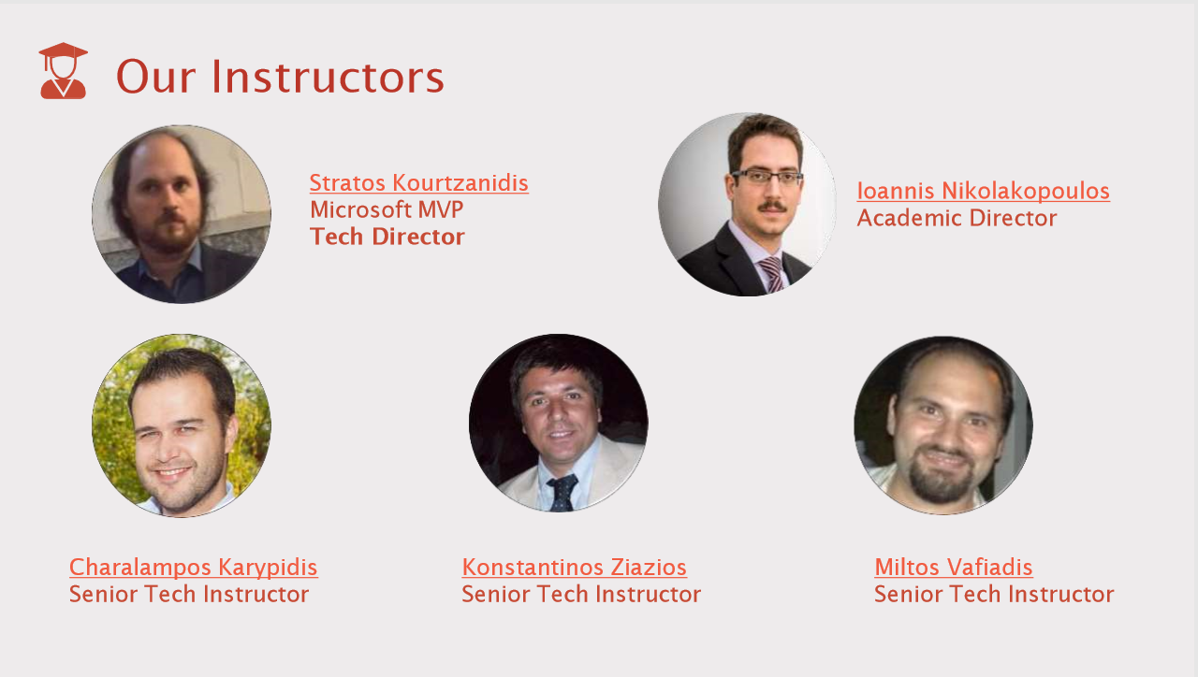

Slide 5
About this course
This course aims to teach the student about the core aspects of web development with asp.net technologies and the C# language.
This course is not a beginner course on C#, although beginners can still learn a lot from the material
At the end of this course, you should be able to:
Use complex data structures and collections with C#
Creating an web application with ASP.NET
Creating and managing databases with EF
Programming with core web technologies (HTML5, CSS, and Javascript)
Understanding the modern web methodologies and concerns
Using collaboration tools like git, and vsts
Build a complex, data-driven webapp
Deploy a webapp to cloud such as azure.

Slide 6
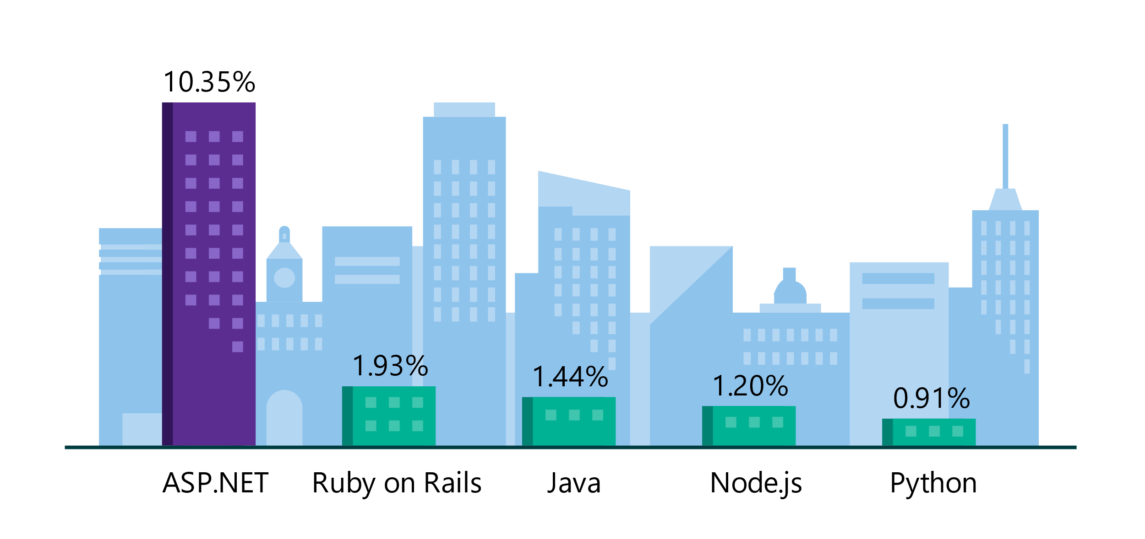
.NET is the platform of choice for the top 100K websites
More websites have been developed with ASP.NET than Ruby, Java, Python, Node.js, and Go combined.
Companies like Raygun, GoDaddy, and Tencent choose .NET for better performance, increased flexibility, and higher compatibility.
Data sourced from SimilarTech
Notes:
https://www.similartech.com/categories/framework
ASP.NET is the name of the web framework for .NET. As you can see there are more top websites developed with .NET than these other technologies. Only PHP has more.

Slide 7
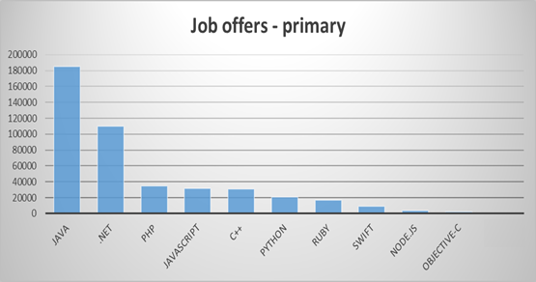
.NET is a sought after job skill
#2 demanded primary technology
(LinkedIn)
Notes:
Everybody wants to have a successful career and that means finding a job. There are a LOT of .NET jobs available since it’s been around for over 15 years. And in general, there are a huge amount of programming jobs.

Slide 8
Getting around the course
How this workshop works
Practical approach, in each session there is a brief presentation of theory, followed by an hands-on example.
How students should work
We encourage you to take your time and work through the material carefully until you have mastered the concepts by trying the examples and exercises each week.
Material (presentations and source code)
Github repository with all material and references.
Communication channels
Slack channel for questions

Slide 9
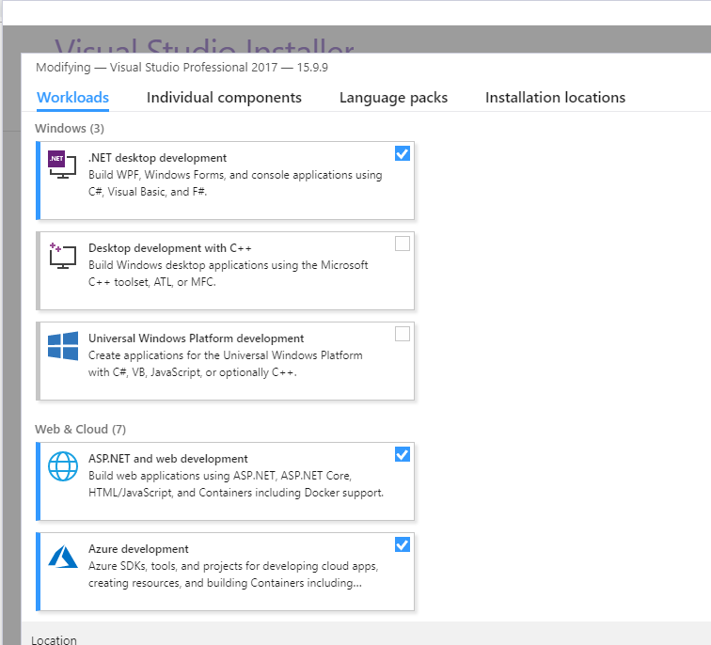
Getting Started 1/3
Installing Visual Studio 2017
3 versions community, professional, enterprise
Visual Studio Community is a fully-featured, extensible, free IDE for creating modern application
https://visualstudio.microsoft.com/vs/community/
Download and open vs_studio installer
Create account
Notes:
Community
Powerful IDE, free for students, open-source contributors, and individuals
Professional
Professional IDE best suited to small teams (free trial)
Enterprise
Scalable, end-to-end solution for teams of any size (free trial)
Tips – Before install the visual studio
https://visualstudio.microsoft.com/vs/support/need-installing-visual-studio/
https://docs.microsoft.com/en-us/visualstudio/productinfo/vs2017-system-requirements-vs

Slide 10
Demo Get started with .NET in your browser
Notes:
In-Browser tutorial:
www.dot.net → Get Started → Select In-browser tutorial
https://www.microsoft.com/net/learn/in-browser-tutorial/1
-- Have the class walk through some of the lessons.

Slide 11
Getting Started 2/3
Running visual studio
After the installation is completed, start visual studio from Start Menu
Create a console app
Select Run!
All is set-up
Notes:
Community
Powerful IDE, free for students, open-source contributors, and individuals
Professional
Professional IDE best suited to small teams (free trial)
Enterprise
Scalable, end-to-end solution for teams of any size (free trial)
Tips – Before install the visual studio
https://visualstudio.microsoft.com/vs/support/need-installing-visual-studio/
https://docs.microsoft.com/en-us/visualstudio/productinfo/vs2017-system-requirements-vs

Slide 12
Visual studio
Visual Studio is an integrated development environment (IDE).
The “integrated” part of IDE means that
Visual Studio contains features that complement every aspect of software development:
Notes:
https://tutorials.visualstudio.com/vs-get-started/intro

Slide 13
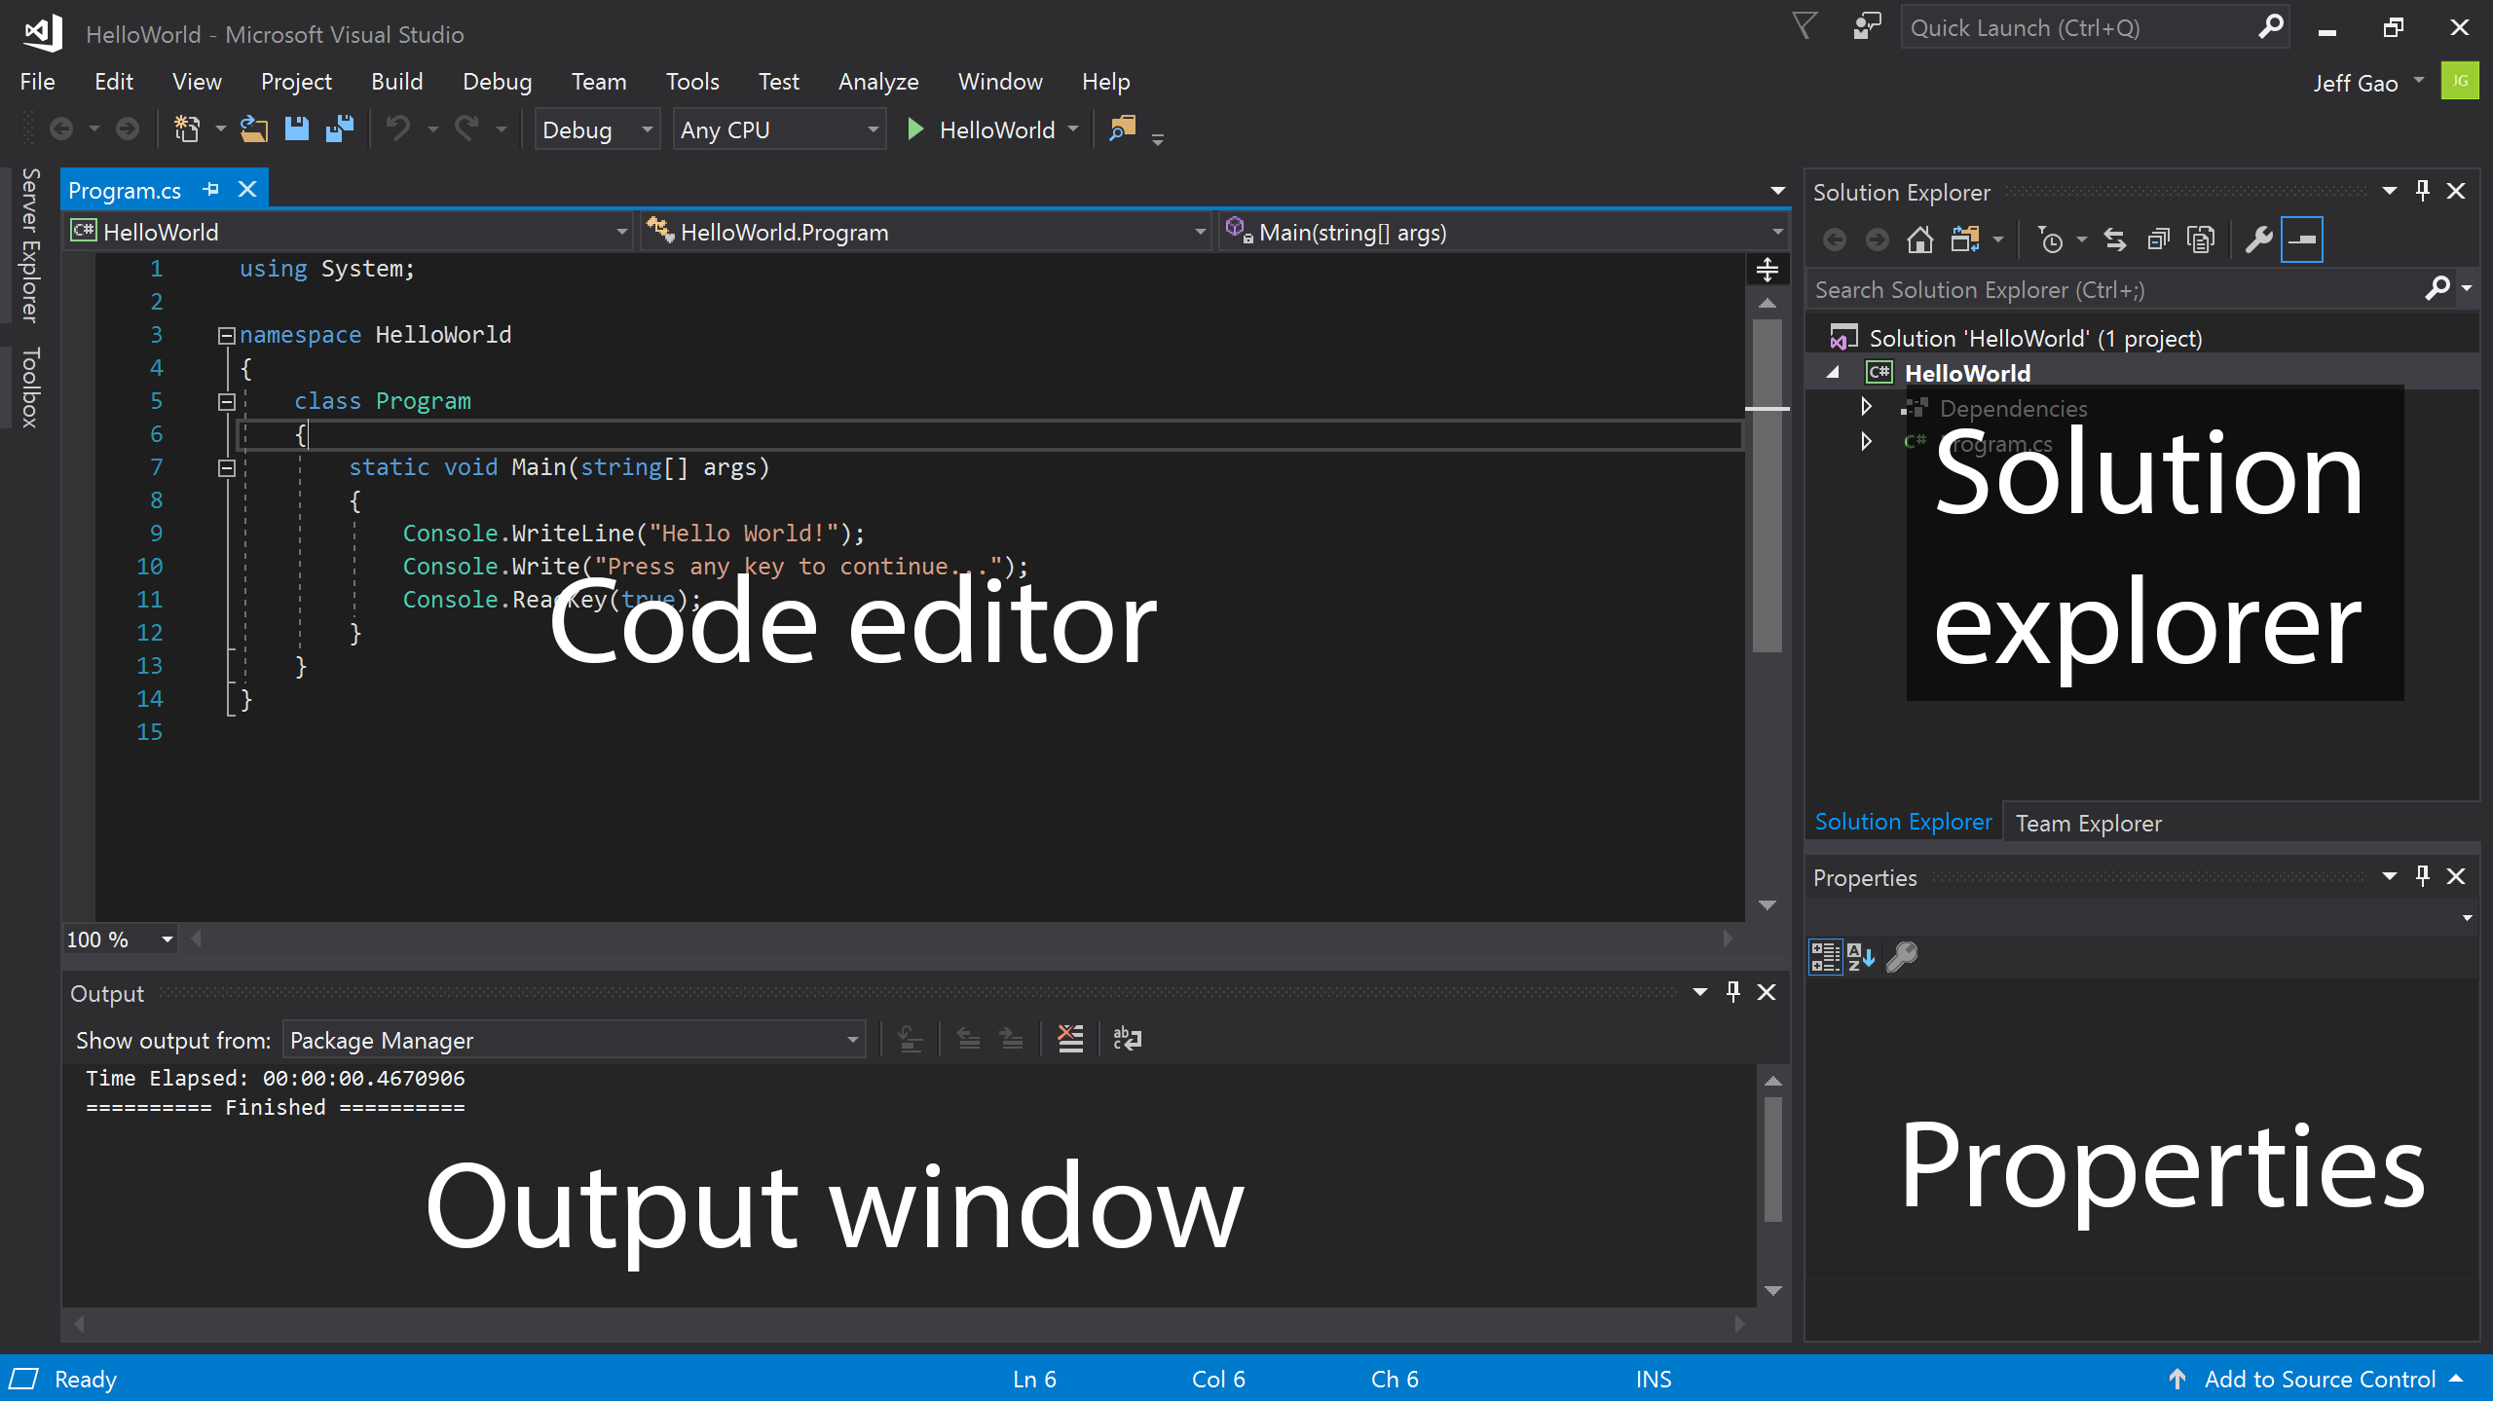
Visual studio
Notes:
The Code editor is where you write your code.
The Solution explorer shows the files you’re working with.
The Properties pane gives additional information and context about selected parts of your project.
The Output window displays debugging and error messages, compiler warnings, status messages, and other output.

Slide 14
Introduction to GIT
Git is an Open Source Distributed Version Control System
Control System: This basically means that Git is a content tracker. So Git can be used to store content — it is mostly used to store code due to the other features it provides.
Version Control System: The code which is stored in Git keeps changing as more code is added. Also, many developers can add code in parallel. So Version Control System helps in handling this by maintaining a history of what changes have happened.
Distributed Version Control System: Git has a remote repository which is stored in a server and a local repository which is stored in the computer of each developer. This means that the code is not just stored in a central server, but the full copy of the code is present in all the developers’ computers.

Slide 15
Getting Started 3/3
Installing Git
For windows go to https://git-scm.com/download/win
Download
Install
Add to path
Open PowerShell
Run git –version
git config --global user.name "Sam Smith"
git config --global user.email sam@example.com
All is set-up

Slide 16
Demo Get started with Git
Notes:
In-Browser tutorial:
www.dot.net → Get Started → Select In-browser tutorial
https://www.microsoft.com/net/learn/in-browser-tutorial/1
-- Have the class walk through some of the lessons.

Slide 17
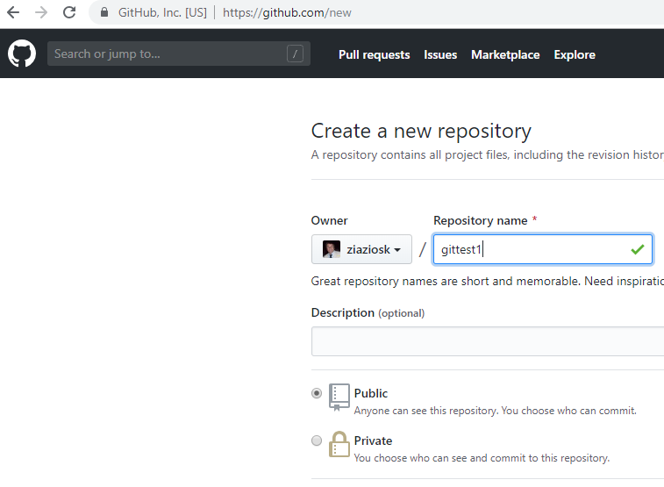
Introduction to Git
Step 0: Install git and create a GitHub account
Step 1: Create a new repository on GitHub
Notes:
https://git-scm.com/book/en/v2/Getting-Started-Installing-Git
https://github.com/join

Slide 18
Introduction to Git
Step 2: Init repo with a readme file - Create folder gittest mkdir gittest
- Add a file
echo "# gittest" >> README.md
git init
git add README.md
Step 3: Commit Changes
git commit -m "first commit”
Step 4: Push Changes
git remote add origin https://github.com/ziaziosk/gittest.git
git push -u origin master

Slide 19
Introduction to GIT – Basic terminology
Branch
Checkout
Cherry-picking
Clone
Fetch
Fork
HEAD
Index
Master
Merge
Origin
Notes:
https://confluence.atlassian.com/bitbucketserver/basic-git-commands-776639767.html

Slide 20
Introduction to GIT – Basic terminology
Pull/Pull Request
Push
Rebase
Remote
Repository
Stash
Tag
Upstream
Notes:
https://linuxacademy.com/blog/linux/git-terms-explained/

Slide 21

Azure DevOps formerly known as Visual studio online
Microsoft platform for managing projects Create account here : https://visualstudio.microsoft.com/vso/
Notes:
https://visualstudio.microsoft.com/vso/
https://docs.microsoft.com/en-us/azure/devops/user-guide/what-is-azure-devops-services?view=azure-devops

Slide 22
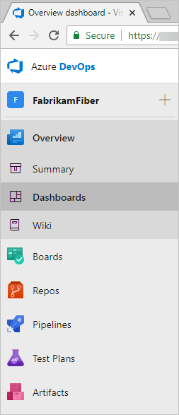
Quick Review
Dashboards
Source control
Plan and track work
Continuous integration and deployment
Testing
Collaboration services
Administrative services
Notes:
https://visualstudio.microsoft.com/vso/
https://docs.microsoft.com/en-us/azure/devops/user-guide/what-is-azure-devops-services?view=azure-devops

Slide 23
Demo Manage a project with Azure DevOps
Notes:
In-Browser tutorial:
www.dot.net → Get Started → Select In-browser tutorial
https://www.microsoft.com/net/learn/in-browser-tutorial/1
-- Have the class walk through some of the lessons.

